Slide 1
Securing the Application Deployment in K8s
Roger Carhuatocto
Version 1.3

Slide 2
1. Security Principles
The Container-based Applications are a kind of Distributed System.
Stick with these security principles:
  Separation of Duties
  Principle of least/minimal Privilege
  Identity-based Security
  End-to-end security (secure management traffic - secure data plane)
  Zero-trust Network

Slide 3
2. The scope
Container-based Application Security
Infrastructure Security
K8s provides the right security features: Protection of secrets, identity and network; Logging and Monitoring, Secure Data & Control Plane, Update (Patching) Cluster components, etc.
Software Supply Chain
It’s about knowing exactly what’s being deployed in your environment and that you control your apps, from code to image to deployment: Secure base images, Vulnerability scanning, Deployment policies, Regular builds, etc.
Runtime Security
It is about ensuring that Sec & Ops teams can detect and respond to security threats to containers running in our environment: L4/L7 Monitoring, Anomalous activity detection (IDS), Continuous Assessment (Scanning), etc.

Slide 4
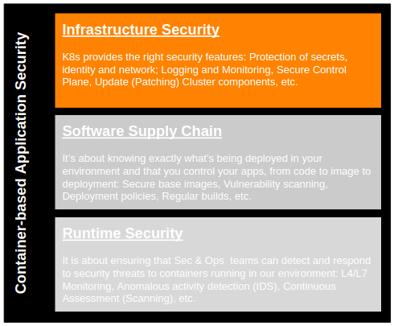
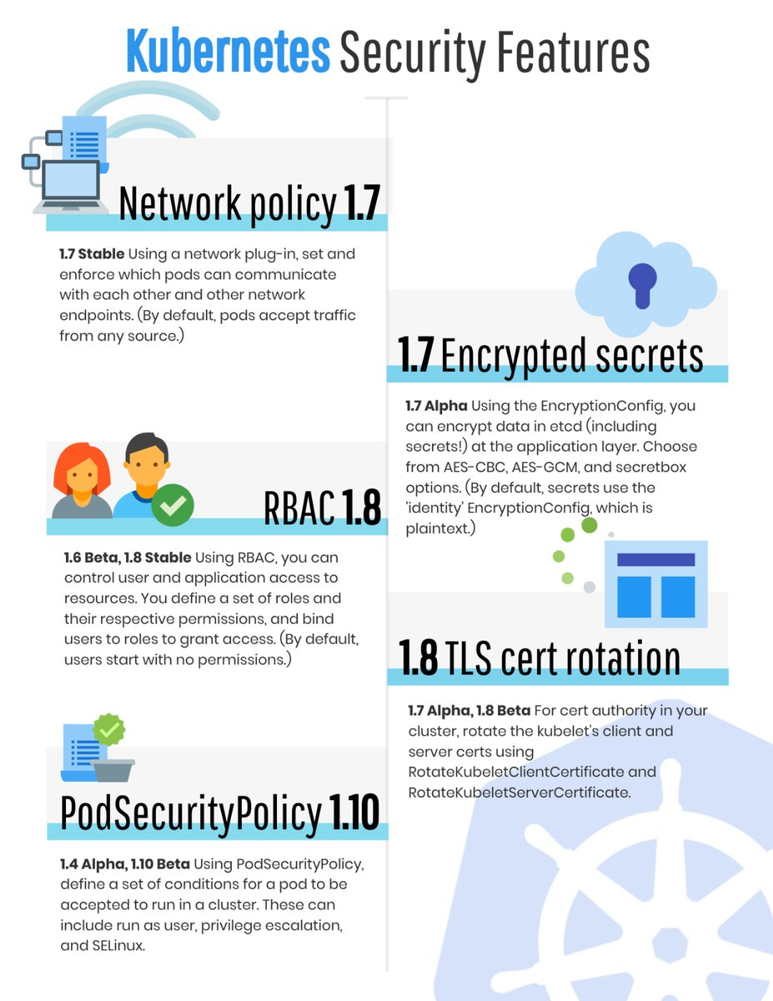
3. Minimum Viable “Security”

Slide 5
4. Threat Modeling

Slide 6

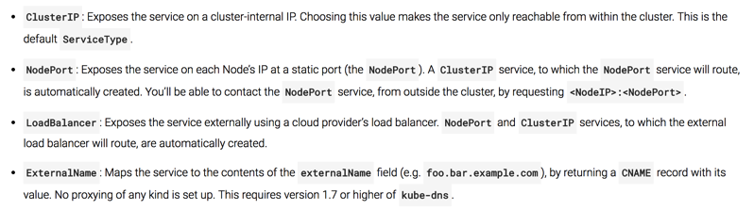
4.1. App Delivery: Pods & Services
Hosting (Amazon EC2, Google Kubernetes, Minikube, etc.)
Docker Registry
Node₁
Edge Proxy
(Load Balancer)
NS_{A}
Port₁
LoadBalancer
NS_{A}
NS_{B}
nodePort₁
(hello-svc-lb)
Pod₁
Pod₃
Docker₁
DNS
Port₂
NodePort
nodePort₂
(hello-svc-np)
(hello-v1)
Port₃
ClusterIP
Pod₂
Node₂
(hello-svc-cip)
Namespace_{C}
Docker₂
Pod₄
2
(hello-v2)
apiVersion: extensions/v1beta1
kind: Deployment
metadata:
name: hello-v1
namespace: hello
spec:
replicas: 1
template:
metadata:
labels:
app: hello
version: v1
spec:
serviceAccountName: helloworld-sa
containers:
- name: helloworld
image: istio/examples-helloworld-v1
imagePullPolicy: IfNotPresent
ports:
- containerPort: 5000
Docker₄
Services
1
Deployment
2
Kubernetes Services:
1
Deployment

Slide 7
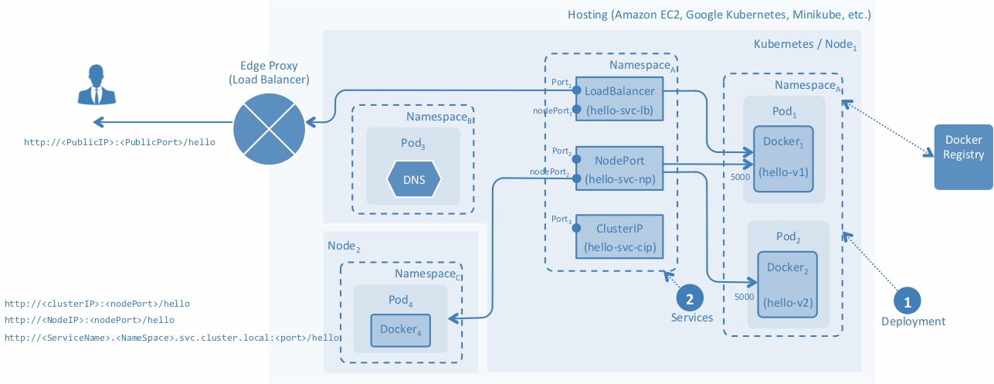
4.2. App Delivery: Pods & Services - Issues
Any container can hit to other container running in different namespaces.
Too difficult to add security (MTLS, ACL, ..)
I’ve deployed my App (Pods & Services) in Kubernetes. Now, Will the CI/CD scale?, Is that secure?
Too difficult to add more routes.
Sometimes the Edge Proxy should be managed / reconfigured everytime a new Route is added/changed.

Slide 8
4.3. App Delivery: Ingress
Hosting (Amazon EC2, Google Kubernetes, Minikube, etc.)
Edge Proxy
(Load Balancer)
Node₁
Ingress Controller
NS_{A}
Ingress₁
NS_{A}
LB
....
Port₁
LoadBalancer
NS_{A}
Ingress_{n}
nodePort₁
(hello-svc-lb)
Pod₁
Docker₁
1
Port₂
NodePort
nodePort₂
(hello-svc-np)
(hello-v1)
2
Deployment
3
Service
Ingress
Port₃
ClusterIP
Pod₂
(hello-svc-cip)
Docker₂
NS_{B}
Pod₃
DNS
Call NodePort or ClusterIP to Pods
(hello-v2)
Ingress Controller
---
apiVersion: v1
kind: Service
metadata:
name: hello-svc-np
labels:
app: hello
namespace: hello
spec:
type: NodePort
ports:
- name: http
port: 5030
targetPort: 5000
selector:
app: hello
---
---
apiVersion: extensions/v1beta1
kind: Ingress
metadata:
name: hello-ing
annotations:
kubernetes.io/ingress.class: istio
spec:
rules:
- http:
paths:
- path: /hello
backend:
serviceName: hello-svc-np
servicePort: 5030
---
1
Deploy the chosen Ingress Controller in Pods and in a specified Namespace. Default HTTP Backend with custom error pages can be implemented.
Configure and integrate the deployed Ingress Controller with the EdgeProxy (Firewall, Root Proxy, Load Balancer, etc.). Generally, Ingress Controller is configured as Kubernetes Service LoadBalancer.
2
3
Finally, during CD time, every API/Microservice will be deployed with Ingress Resource definition (routing). TLS, MTLS over HTTP can be defined.
Notes:
What Ingress Controller can i use?
An Ingress Controller is a Proxy that works as Kubernetes Controller. They manage the traffic between EdgeProxy and Service Mesh (APIs/Microservices).
A Proxy deployed in Pods doesn’t mean that you have an Ingress Controller.
There are several Ingress Controller implementations, they can manage different kind of traffic (HTTP, HTTPS, gRCP, Websockets, TCP, UDP, …) and different functionalities (VIP, Virtual Hosts, Paths, …); then the chosen Ingress Controller depends on the kind of traffic that your API/Microservices manage and how they were implemented (Ports exposed, Paths used, Headers expected, etc.)
Examples:
Heptio Contour (based on Envoy Proxy)
Istio Ingress Controller (based on Envoy Proxy)
Linkerd Ingress Controller (based on Linkerd Gateway)
HAProxy Controller (based on HAProxy)
NGINX Controller (based on NGINX), etc.
See LB, Gateways, Proxies, Ingress Controllers, Sidecars (Secure Data Plane) comparison here:
https://drive.google.com/open?id=1_vLkVTI2j4PxMwzMwT-yZtvYioon3vIbdBIEexCFK9I
https://drive.google.com/open?id=1Ms0xtBiiDiv4IIswClQ1R0_Ua52AMxIFZJ7yMWPUOY0

Slide 9
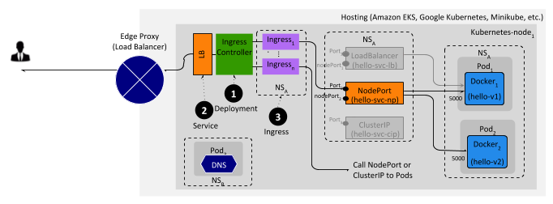
4.4. App Delivery: Ingress - Issues
It isn’t secure because the Pods still are accesibles. Any other Pod (container) can call this.
I’ve implemented the Ingress Controller. Now, Is that 100% Secure?
It isn’t secure because that doesn’t have:
Separation of Duties
Principle of Last Privilege
Identity-based Security
End-to-end security: the App Container still is “open” and nobody can stop to make call to that Container.
Container Patterns (sidecar container as last-mile protection)
Registry, Auditability and Traceability. It means that all App Containers (APIs and Microservices) living in the Service Mesh should be Identified and Traceable.
Notes:
What Ingress Controller can i use?
An Ingress Controller is a Proxy that works as Kubernetes Controller. They manage the traffic between EdgeProxy and Service Mesh (APIs/Microservices).
A Proxy deployed in Pods doesn’t mean that you have an Ingress Controller.
There are several Ingress Controller implementations, they can manage different kind of traffic (HTTP, HTTPS, gRCP, Websockets, TCP, UDP, …) and different functionalities (VIP, Virtual Hosts, Paths, …); then the chosen Ingress Controller depends on the kind of traffic that your API/Microservices manage and how they were implemented (Ports exposed, Paths used, Headers expected, etc.)
Examples:
Heption Contour (based on Envoy Proxy)
Istio Ingress Controller (based on Envoy Proxy)
Linkerd Ingress Controller (based on Linkerd Gateway)
HAProxy Controller (based on HAProxy)
NGINX Controller (based on NGINX), etc.

Slide 10
4.5. App Delivery: Ingress and Sidecar
Hosting (Amazon EKS, Google Kubernetes, Minikube, etc.)
Edge Proxy
(Load Balancer)
Node₁
NS_{secure}
NS_{A}
Ingress Controller
Ingress₁
NS_{A}
LB
Services
....
LoadBalancer
Pod₁
Ingress_{n}
(hello-svc-lb)
Docker₁
NodePort
Sidecar_{x}
1
Port₂
(hello-svc-np)
5000
(hello-v1)
nodePort₂
7
2
Deployment
3
ClusterIP
Pod₂
Service
(hello-svc-cip)
Docker₂
TLS Pass-through and Termination config.
AuthN + AuthZ
Ingress
Sidecar_{y}
5000
(hello-v2)
Registry
Call NodePort or ClusterIP to Pods
4
Container Patterns
6
Registry and Discovery
5
“Identity-based Security” strategy
Ingress Controller
Secure Traffic Management and L7 Filtering
1
Deploy the chosen Ingress Controller in Pods and in a specified Namespace. Default HTTP Backend with custom error pages can be implemented.
4
Inject Sidecar in the same Pod where the App Container is living. Sidecar bootstraps security config. to reject traffic from untrusted source.
+
5
The “Single Source of Truth“ does validate and authorize the incoming traffic.
Configure and integrate the deployed Ingress Controller with the EdgeProxy (Firewall, Root Proxy, Load Balancer, etc.). Generally, Ingress Controller is configured as Kubernetes Service LoadBalancer.
2
It provides a fine-grained control over all App Containers running in the Service Mesh.
6
Finally, during CD time, every API/Microservice will be deployed with Ingress Resource definition (routing). TLS, MTLS over HTTP can be defined.
7
The TLS termination should be configured properly in order to be managed dynamically for the Ingress Controller. It means to manage the lifecycle of the TLS Certs.
3

Slide 11
4.6. App Delivery: Ingress, Sidecar & Network Policy
Hosting (Amazon EC2, Google Kubernetes, Microsoft Azure, etc.)
Kubernetes Node₁
Edge Proxy
(Load Balancer)
NS_{secure}
NS_{A}
Ingress Controller
Ingress₁
NS_{A}
LB
Services
...
LoadBalancer
(hello-svc-lb)
Pod₁
Ingress_{n}
Docker₁
NodePort
(hello-svc-np)
Sidecar
1
(hello-v1)
7
2
Deployment
3
ClusterIP
(hello-svc-cip)
Pod₂
Service
Ingress
Docker₂
TLS Pass-through and Termination config.
AuthN+AuthZ
Sidecar_{y}
(hello-v2)
Registry
SDN-CNI Provider
5
Call NodePort or ClusterIP to Pods
4
Container Patterns
“Identity-based Security” strategy
6
Registry and Discovery
8
Network Policy
Ingress Controller
Secure Traffic Management and L7 Filtering
Secure Traffic Management (L3/L4 Firewall)
1
Deploy the chosen Ingress Controller in Pods and in a specified Namespace. Default HTTP Backend with custom error pages can be implemented.
4
Inject Sidecar in the same Pod where the App Container is living. Sidecar bootstraps security config. to reject traffic from untrusted source.
TLS termination should be configured per use case to enable/disable TLS and manage the lifecycle of the TLS Certs too.
7
+
5
Identity validation to authorize the traffic.
+
2
Configure and integrate the deployed Ingress Controller with the Edge Proxy (Firewall, Load Balancer, etc.). Generally, Ingress Controller is configured as Kubernetes Service LoadBalancer.
6
It’s part of Control Plane, provides a fine-grained control over all Containers running in the Data Plane.
The Sidecar assures End-to-end TLS communication (between API/Microservice and Edge Proxy through Ingress Controller). Additionally, Sidecar manages the TLS Certificate Lifecycle (revocation, renewal, validations, etc.)
4
3
Finally, during CD time, every API/Microservice will be deployed with Ingress Resource definition (routing). TLS, MTLS or HTTP can be defined.
7
TLS termination should be configured per use case to enable/disable TLS and manage the lifecycle of the TLS Certs too.

Slide 12
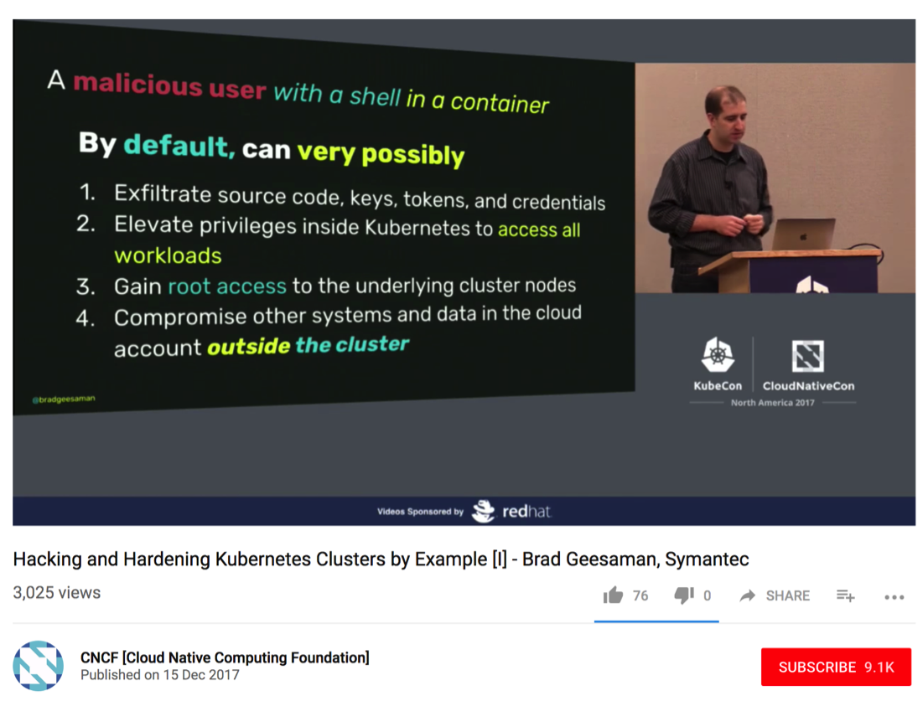
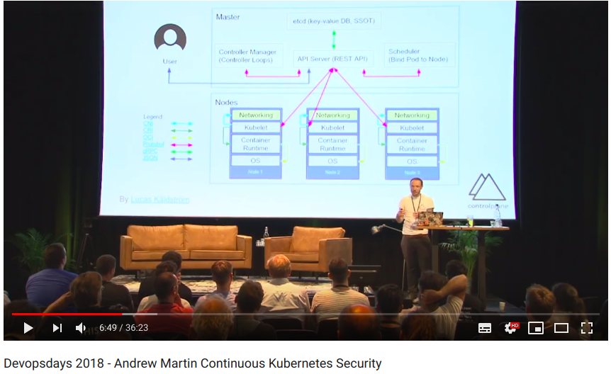
5. Container-based Apps brings new threat vectors
https://www.youtube.com/watch?v=vTgQLzeBfRU
https://www.youtube.com/watch?v=G1zjNX4roAY
https://kubernetes.io/blog/2018/07/18/11-ways-not-to-get-hacked

Slide 13
6. What should we do?
Infrastructure Security
Network Policy
Encryption
Holistic Monitoring
Container-based Application Security
TLS cert rotation
PKI & Secrets Management
Pod Security Policy
RBAC
Software Supply Chain
DevOps (CI/CD, Ops)
Security Principles and Patterns
DevSecOps
Runtime Security
Isolation & Sandboxing
Continuous Security Assessment
Time

Slide 14
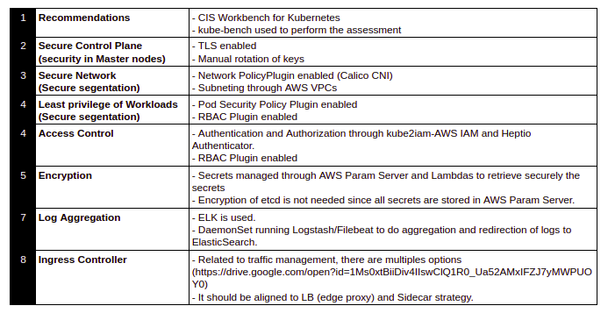
7. Checklist

